Slide 1
Git
An Adventure in Time Travel and Collaborative Storytelling

Slide 2
Agenda
Setup (GitHub Desktop, GitHub Account) ~15m
Introduction to Git ~10m
Exercise: A Collaborative Story ~30m
Thanks ~5m
Feel free to grab food anytime you feel hungry!

Slide 3

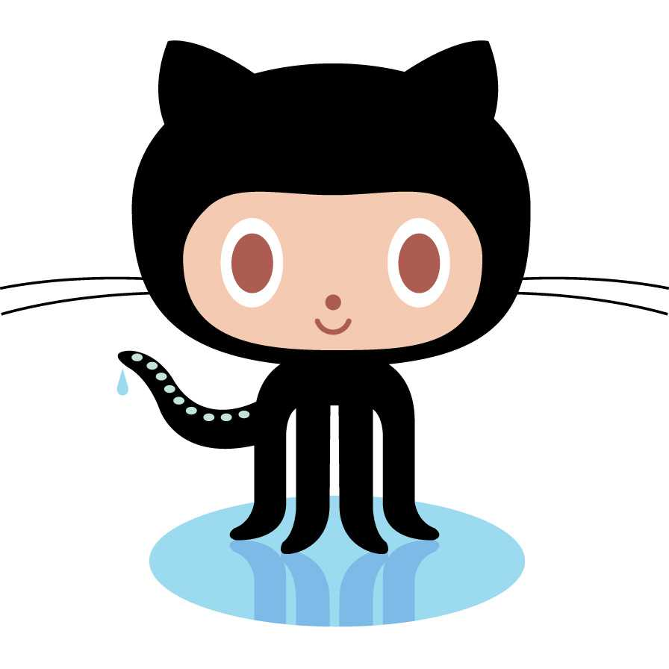
Introduction
(This is probably a good time to grab some food)
What is Git? Why does it matter.
Git is a selective time machine (construction yard eg)
Git is a Version Control System (a way to manage the history of a project)
Without Git: Troubles of Project Collaboration (multiple files, unclear latest, manual management, big mess…)
Git makes collaboration and project management a breeze.
What is GitHub?
Software Library of Alexandria (largest git repository site in the world).

Slide 4

Git is for everyone
Git and tools like it aren’t just for developers.
It’s popular among developers because of how good it is at managing the “construction” of large projects, but it can (and has) been used by other groups as well.
Git is great for
Design
Development
Writing
Accounting
Anything that has multiple versions or iterations will benefit from this awesomesauce.

Slide 5
Exercise
Collaborative Storytelling

Slide 6
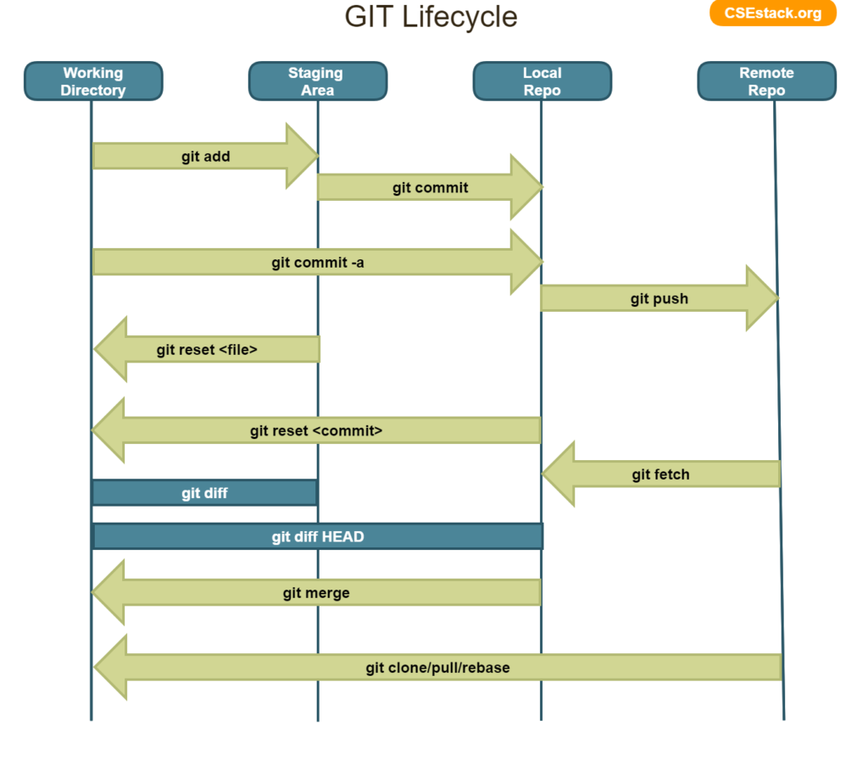
Collaborative Storytelling with Git
Because time is limited we’ll go over the basics
Git is a very robust tool, with lots of special features
We won’t cover everything
Git has 4 “stages”
Git can do/undo actions across stages
There’s lots of atomic operations
We’ll mainly cover rightwards operations

Slide 7
Command Overview
Fork
Clone
Pull
Branch
Add, Remove
Commit, Reset
Merge
Commit, Reset
Push
Pull Request

Slide 8
But enough talking, let’s get hacking!

Slide 9


Start by Forking
Assuming you already have your account and GitHub Desktop set up, we can begin by going to https://github.com/LordUbuntu/GitHub-Workshop and creating a fork
Once that’s done, you will have a local version of of the fork that you have the rights to edit and play with as you please (forks vs clones)
To see it, click on “View On GitHub”
Now open GitHub Desktop
Log in to your account
Click on Add > Clone Repository
Select your remote twin of GitHub-Workshop (Username/GitHub-Workshop)
You now have a local clone of your online repo
You can edit locally, and then push changes remotely

Slide 10
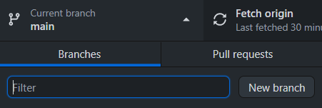
Branches and Changes
To start, we’ll create a new branch (name it after yourself)
Switch to that branch
Click “Show In Explorer” to open up the physical directory of the local repo
Open story.txt and add your own part to the story!
Add and commit those changes to the current branch
See the difference! This is how you do parallel timelines!
Note how this isn’t in the remote repo yet, that’s because we haven’t pushed our changes!
You can publish a branch to a repository, this can be useful for some collab processes

Slide 11
Merging Timelines
We’ve made our changes on the new branch, but they’re not on the main one yet!
To do that, we need to merge the new branch back into the main one
Switch your current branch back to the main branch
Go to menu bar, select branch > merge into current branch
Now we select a branch we want merged into the current branch (main)
Select the branch you had been working on, and click “create a merge commit” to merge the branches and their changes together
Now the branches are merged, and your changes from the branch are now on the main branch instead.

Slide 12

Pushing Changes
Our remote repo is behind our local repo currently, we can update it by pushing a change we’ve committed from our local main branch to the remote main branch
Git (inside of) GitHub Desktop will auto-detect this, and you’ll see this button
Press it to push the changes on your local main branch to your remote main branch (this will sync up the remote with your local changes)

Slide 13
Open Collaboration with Pull Requests
Now that we’re back to our main branch, and it has our latest changes, we can contribute our changes to the repo we forked from.
But the repo we forked from may have already had changes we do not have
So before we can submit anything to it, we need to get ourselves up to speed
To do this, branch > rebase current branch > (rebase / create merge commit)
Commit and push to your remote
To submit a pull request directly go to branch > (compare on GitHub / Create Pull Request)
You’ll be taken to github and given the option to submit a pull request from your remote main to the upstream main
Review it and then submit the PR

Slide 14
Open Collaboration with Pull Requests (Continued)
On the other end, repo owners like me can look at your PR’s, review changes, resolve conflicts, and merge those changes into the main branch.
I’ll show that just now with the changes you’ve all added!

Slide 15
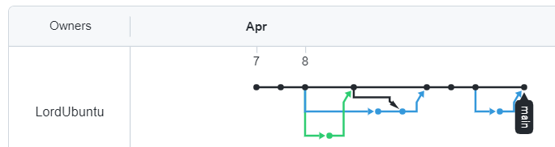
That’s It!
Add as many changes as you would like!
With this knowledge, you can contribute to any open source projects on GitHub! Give it a shot, it’s great practice and looks good on a resume!
(check out graph tree)

Slide 16
Thanks
Thanks to
Herbert Tsang & Alyssa La Mar (support, organization)
Sodexo (food supplies and setup)
You (for attending)
God

